Slide 1



Medical Conditions and STEM Motivation at an Open Enrollment Institution
Institution: Utah Valley University
Area of Research: Science & Technology
Email: porter.bischoff@uvu.edu
Faculty Mentors: Drs. Britt Wyatt and Josh Premo

Slide 2
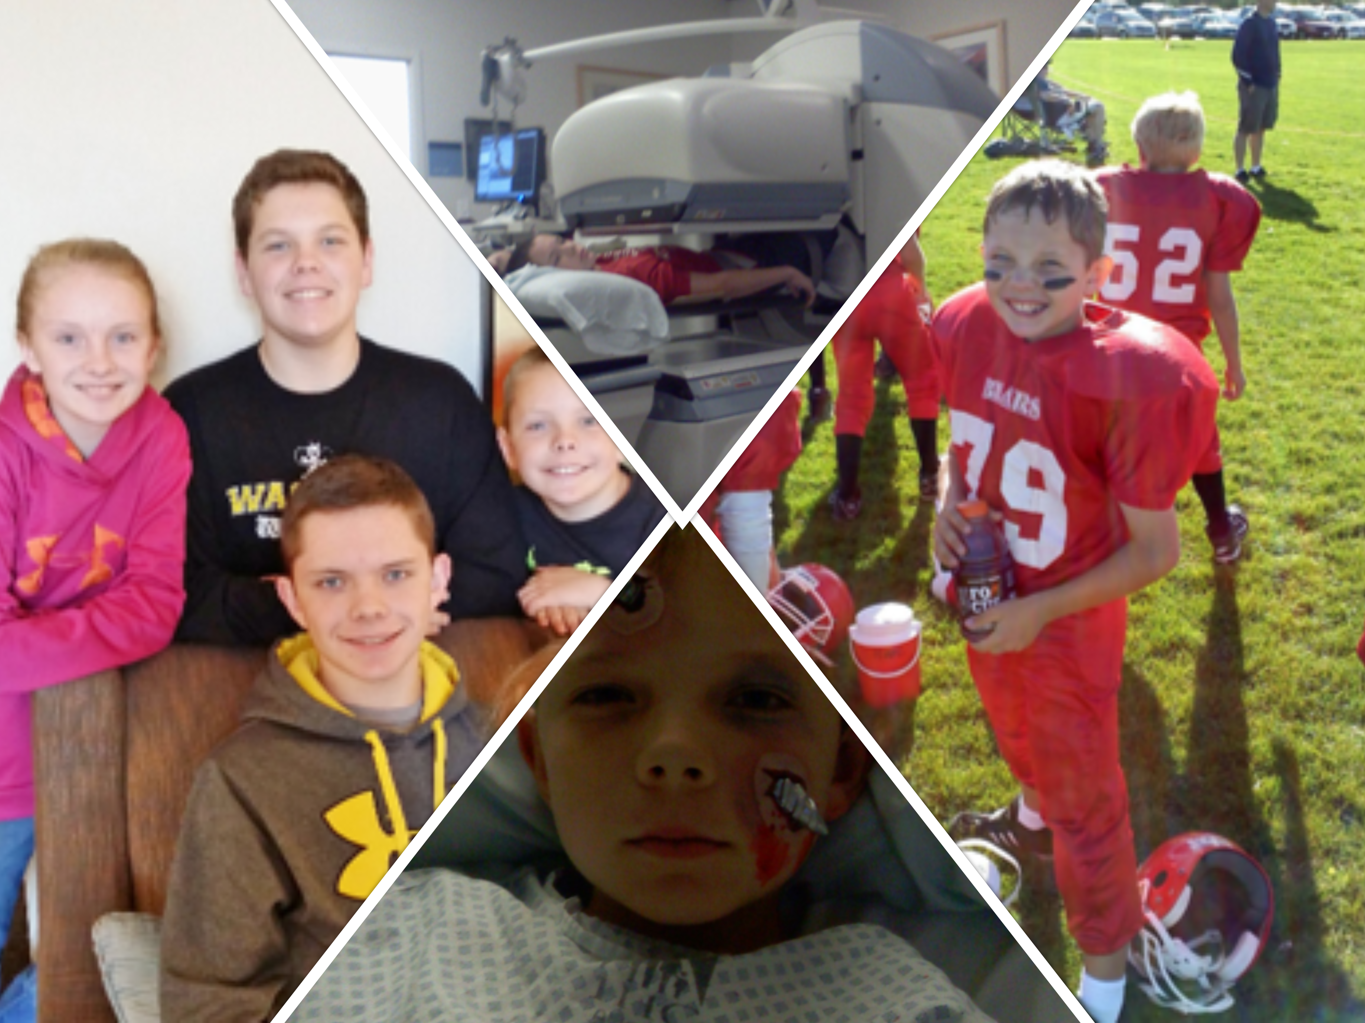
Introduction: A Student’s Perspective

Slide 3
Introduction: Background Research
Connections to STEM:
Connection to the science community is important for minority students. (For example, Estrada et. al, 2011)
Students who feel more connected to the scientific community are more likely to succeed in science. (For example, Christe et. al, 2013)
Recruitment and retention in STEM can be influenced by a student’s connection to the STEM community, science identity, and engagement. (For example, Nadelson et. al, 2017)
Connection to the science community is important for historically underserved, minoritized, and/or PEERS (persons excluded because of their ethnicity or race) (For example, Chemers et. al, 2011)
Impact of Medical Conditions:
Those with medical experiences / chronic conditions in medical school are less likely to complete their degrees. (For example, Pagnin et. al, 2013)
Medical conditions lead to greater disconnection from others and experience higher levels of stress throughout their lives (For example, Campagne et. al, 2019)

Slide 4
Hypothesis
Acute medical experiences may include a limited number of interruptions to one's daily lifestyle and education. These interruptions have a smaller impact on STEM motivation for students without medical conditions in comparison to students with chronic medical conditions.
We focused those who had medical experiences that interrupted their schooling and correlated that back to their sense of belonging, self-efficacy, treatment outcomes, science engagement, etc.

Slide 5
Survey – IRB #936
Fall 2022 Pre-Semester and Post-Semester Data
380 Students

Slide 6
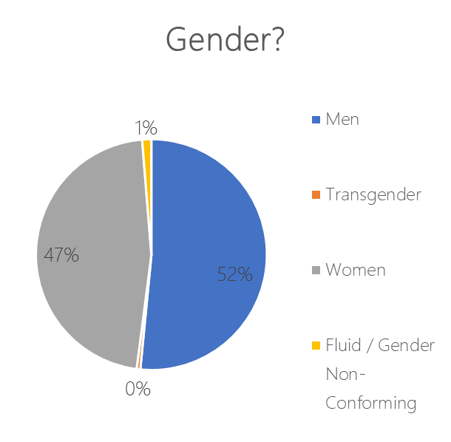
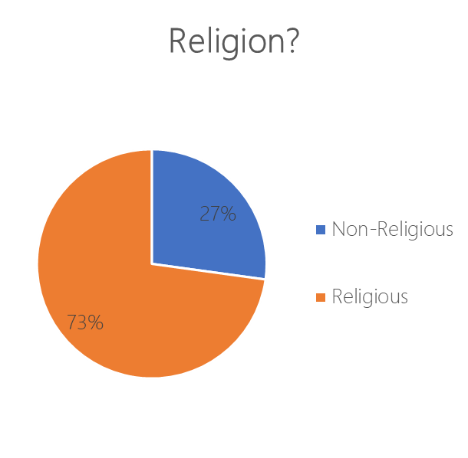
Survey – IRB #936
Fall 2022 Pre-Semester and Post-Semester Data
380 Students

Slide 7
Survey – IRB #936
Fall 2022 Pre-Semester and Post-Semester Data
380 Students

Slide 8
Survey – Question Examples
Sense of Belonging
Self-Efficacy
Treatment Outcomes
“When I am in a science setting, I feel a connection with the science community.”
“When I am in a science setting, I feel respected.”
“I am confident I will do well on science labs and projects.”
“I believe that I can earn a grade of “A” in science.
To what extent was [your treatment outcome] negative or positive?

Slide 9
Survey – Question Examples
Science Engagement
Value of Peers
Self-Determination
"I work on a project involving scientific concepts."
"I think about how my life is affected by science."
“My college science classes are more enjoyable when I work with other students.”
“I learn best in college science classes when I work with classmates.”
“I study hard to learn science.”
“I prepare well for science tests and labs.”

Slide 10
Results
Those with more interruptions to their education because of medical conditions have a lower sense of belonging (r = -.150*) and lower self-efficacy (r = -.164*)
Those with positive treatment outcomes have a more positive science engagement (r = .167*), sense of belonging (r =. 159*), self-determination (r = .225*), self-efficacy (r = .201*), and value of peers in science (r = .188*).
In this sample, 57% of students have had medical experiences, and of that number, 40% of the students have chronic conditions.
* - Pearson Correlation + Significant

Slide 11
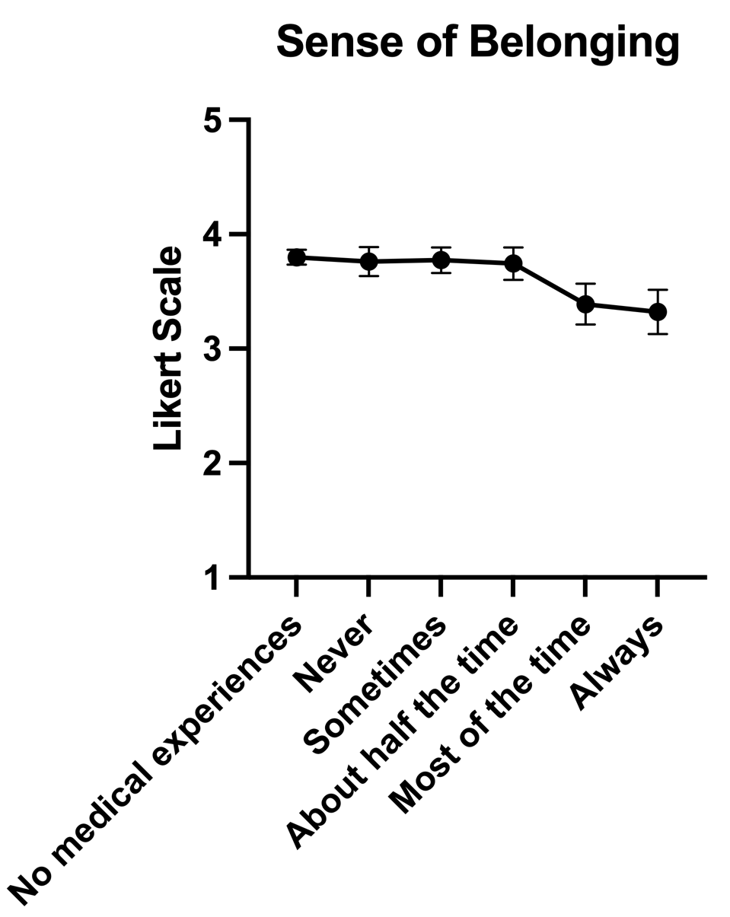
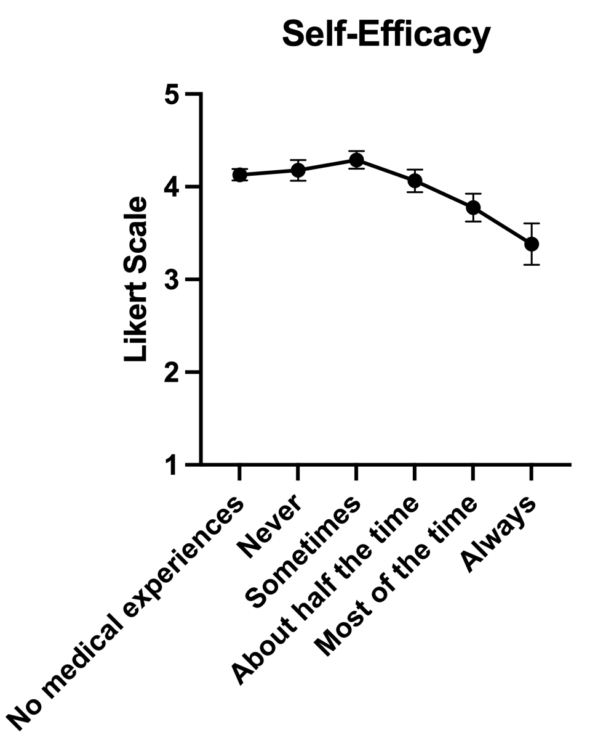
Results

Slide 12

Major Takeaway
https://www.bentley.edu/sites/default/files/2021-04/shutterstock_1427481839_1440x665.png

Slide 13
Next Steps
Further Data Analysis
Future Conferences
Further Data Collection
Does medical experience lead to higher science engagement?
Does gender influence the percentage of medical conditions?
X-DBER (Apr 2023)
SABER (July 2023)
Exploring other options!
- Analyze data from pre-semester 2023 and collect and analyze data from post-semester 2023.

Slide 14


Work done by the iSPIRE Research Group at Utah Valley University
Undergraduate Research Mentors
Dr. Britt Wyatt
Dr. Josh Premo
Undergraduate Students
Science Identity Project
Steven Hughes
Eden Backman
Kerri Hassan
Differential Motivation Project
Porter Bischoff
Kody Garrett
Kerri Hassan
Research focused on undergraduates by undergraduates
Funding:
Bonnie Ballif-Spanvill Endowed Fellowship
UVU College of Science (URSCA Grant)
UVU Biology Department
IRB Approval #936

